Slide 1
How to play Fezul Mastermind
Como jugar Fezul Mastermind

Slide 2
Objective
The purpose of this programming project is to use Python programming to develop the logic and Graphical User Interface (GUI) for FEZUL Mastermind Game. The purpose of the game is to find five (5) distinct colours in the right order that have been randomly selected by the computer from a pool of eight (8) colours.
The player will have twelve (12) opportunities to find the key, at which point the system will display the key at the top of the screen. During each attempt, the computer will provide the player feedback about how many colours are correct and how many colours are in the right location. The player should use this information to predict the next attempt. At any time during the game, the player can exit the game and start a new game.
The system will generate a new colour key any time you start a new game. At the bottom right of the screen, there are some check boxes that will help the player to track their findings.
There is no time limit to complete the game, but it could be added as part of the game in future versions. Multiple players online can be added as well. The same logic with minor modifications could be used for some other mind games like Worldle or Soduko.
The next phase of development of this game is to transfer the logic of FEZUL Mastermind to a smart phone application using Python capabilities. Good luck with that.
Enjoy the game!

Slide 3
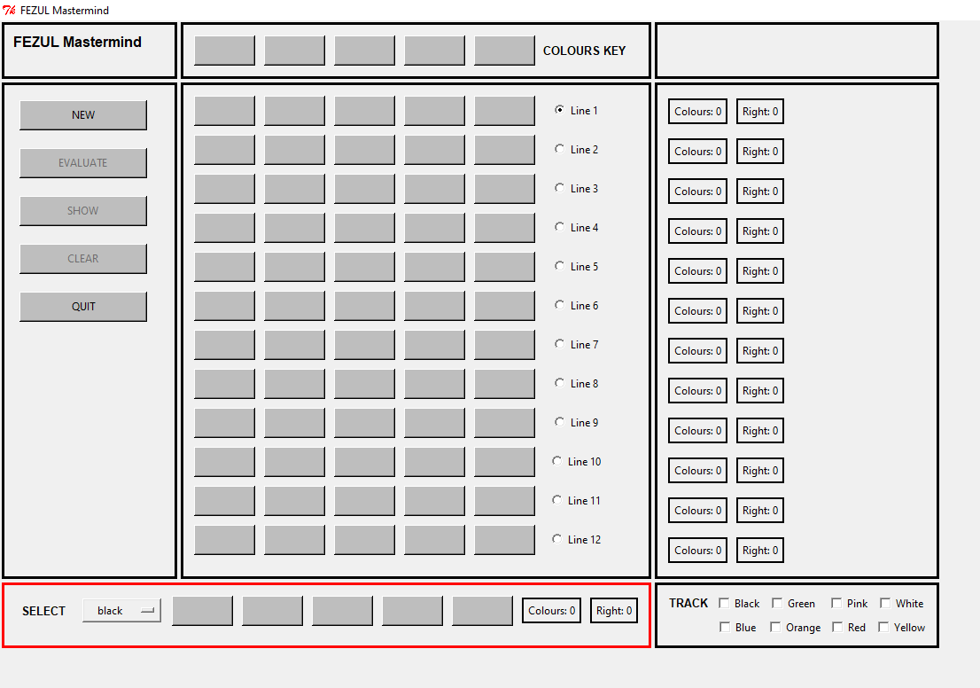

1. To start the game select “new’’
1. Para empezar el juego dar click en new
2. Select any color and click in each bar
2. Seleccionar cualquier color y dar click en la barra deseada

Slide 4
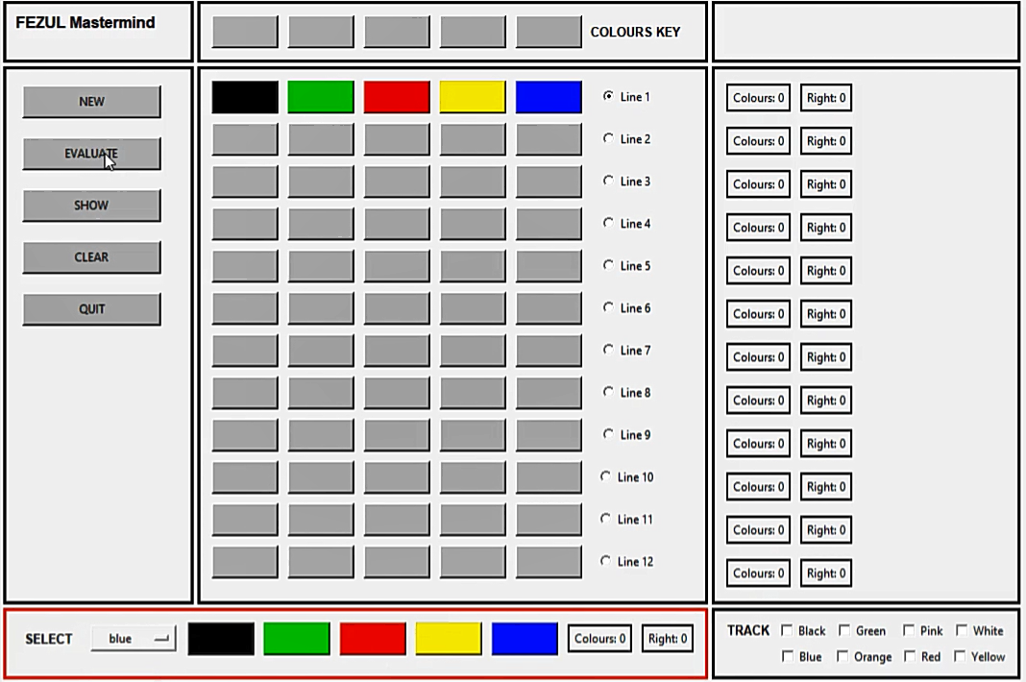

3. They will be shown in each line
3. Se mostraran en cada linea
4. Click “evaluate”
4. Dar click en evaluate

Slide 5
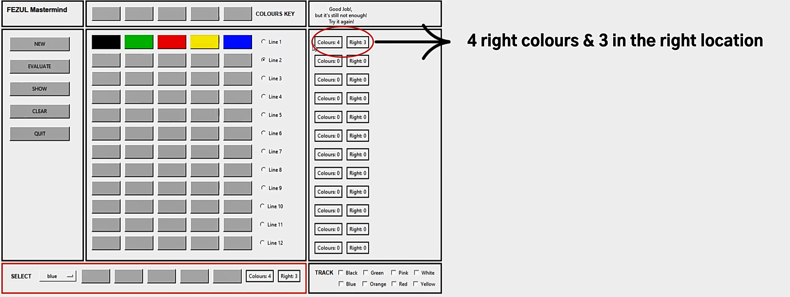
5. You will receive how many colors and positions are right in each line
5. Recibiras la informacion de cuantos colores estan correcto y cuantos en posicion correcta para cada linea

Slide 6
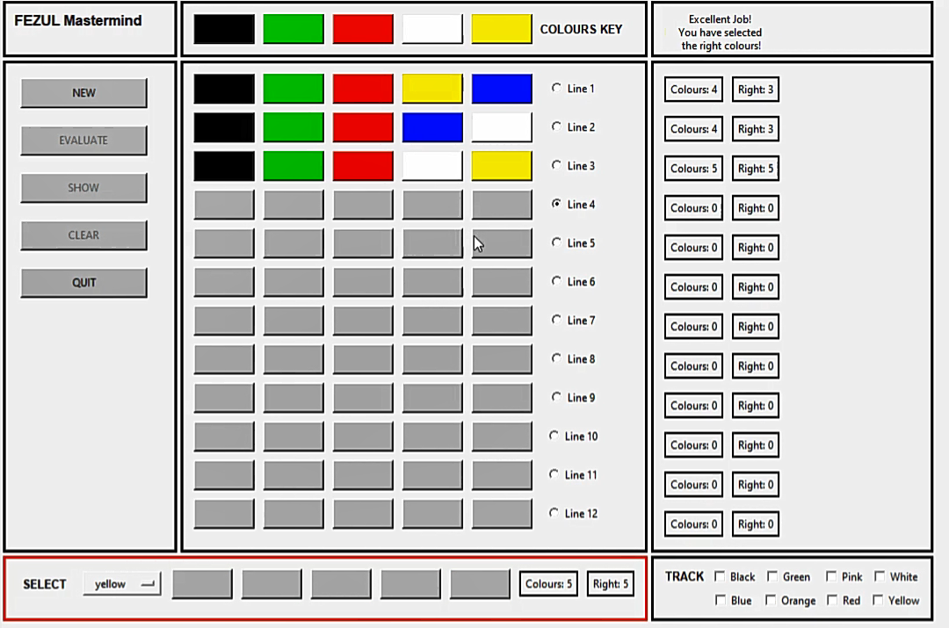
6. Repeat until finding the key
6. Repetir hasta encontrar la secuencia correcta
7. After 12 attempts the key will be shown
7. Despues de 12 intentos la secuencia se mostrara en la parte superior

Slide 7
